Slide 2



Forms Builder Training
This presentation is CONFIDENTIAL and property of Softdocs, Inc. It is to be used only for the purpose intended. Any unauthorized use is strictly prohibited. © 2017 Softdocs, Inc.

Slide 3
Agenda
Form Administration
Accessing the Form Builder
Form Builder
Rows
Columns
Elements
Additional Functions
Do’s and Don’ts
Best Practices

Slide 4
Form Administration

Slide 5
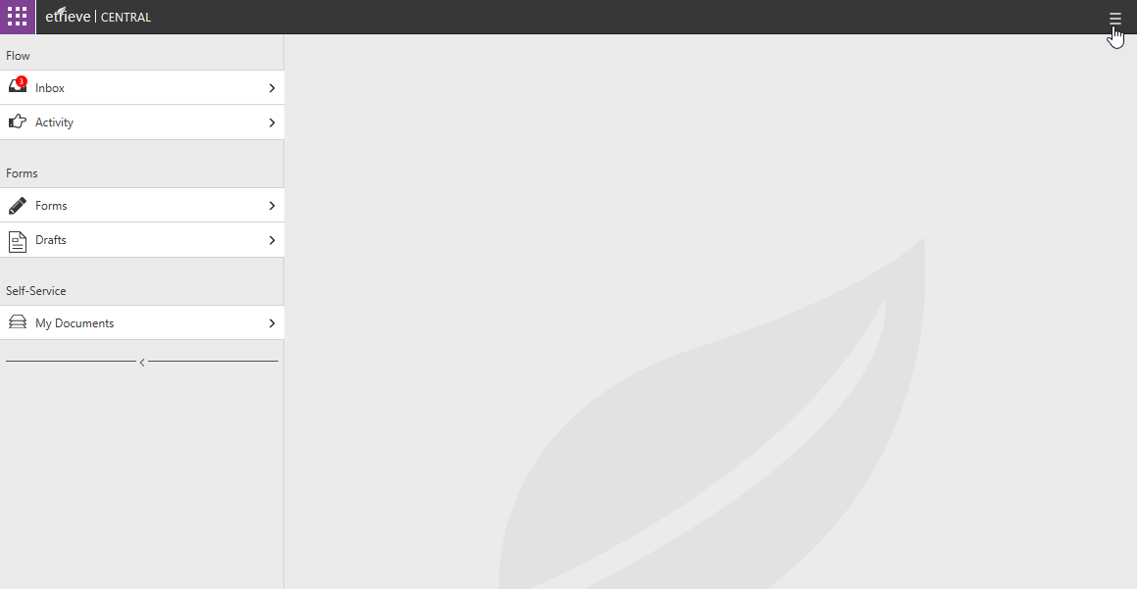
Accessing Form Administration Tools
Click the “hamburger” icon at the top right of the Central Header

Slide 6
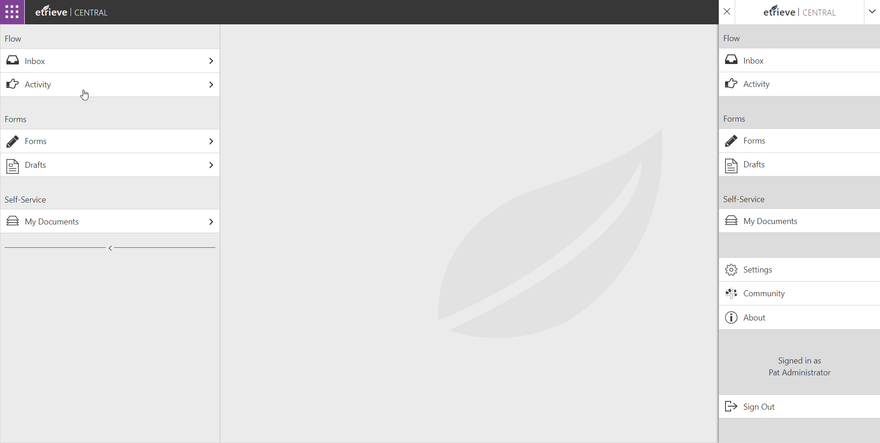
Accessing Form Administration Tools
Click on Settings

Slide 7
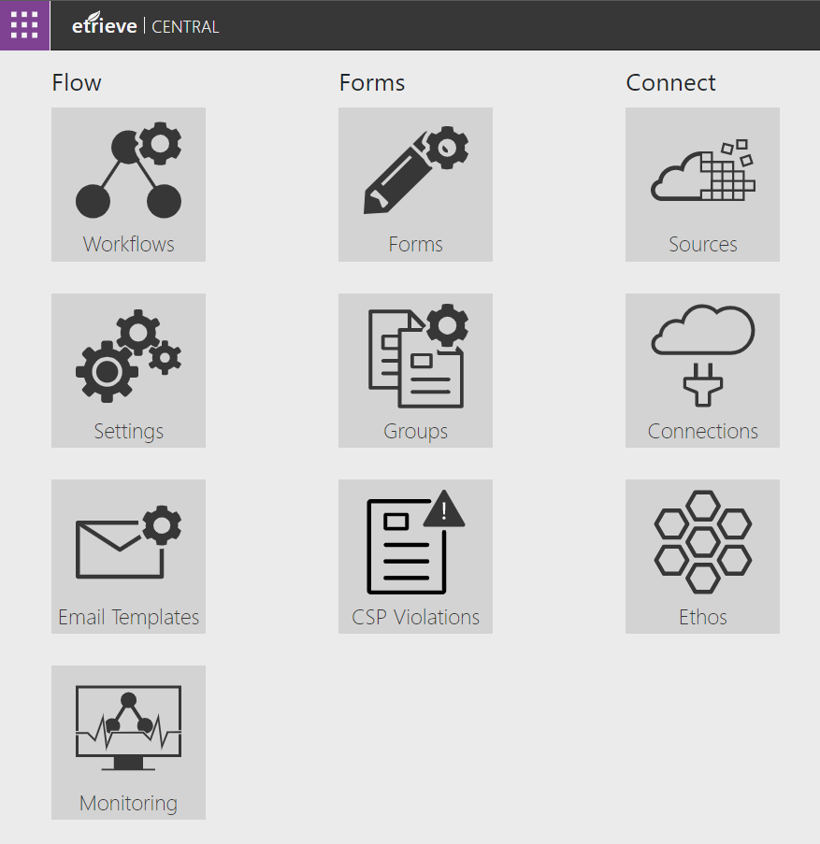
Accessing a Form
Form Builder is found in the Form Administration

Slide 8
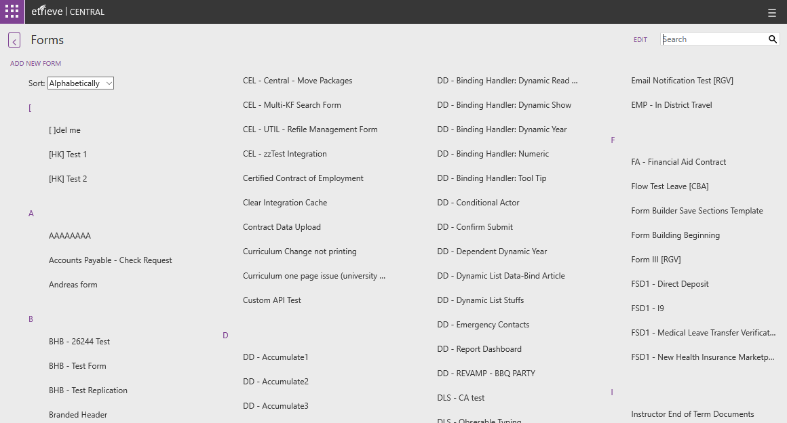
Selecting a Form
The list can be filtered by entering text into the Search field.
Select the applicable form to open the Form Administration page

Slide 9
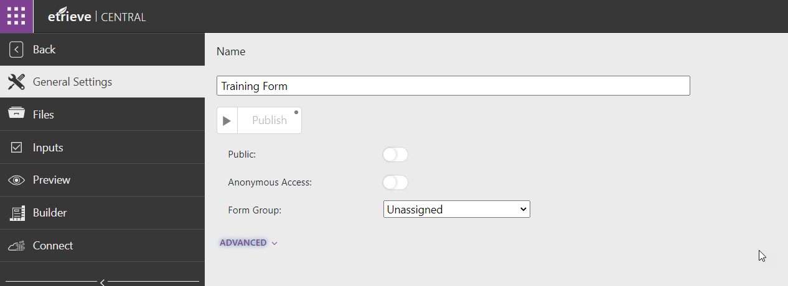
Form Administration
The Form Builder is found by clicking on the Builder tab in the left panel.

Slide 10
Form Builder

Slide 11
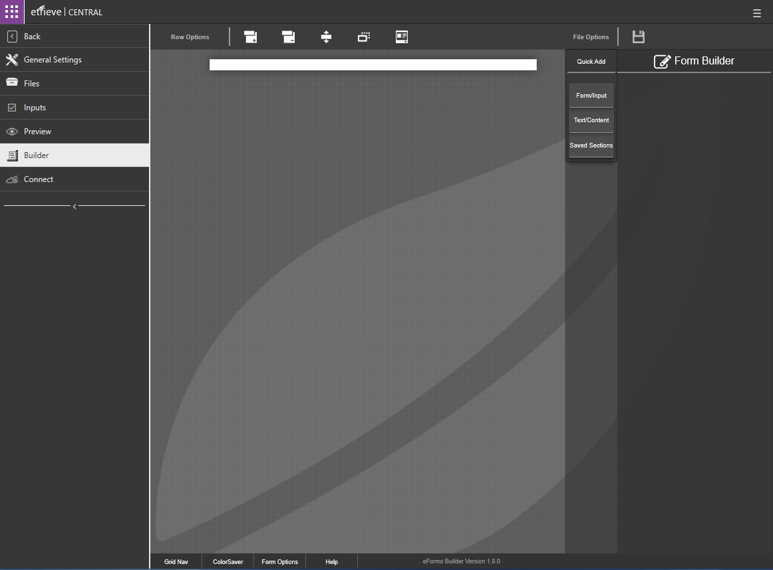
Form Builder
When starting a new Form, the Form Builder window will look like this.

Slide 12
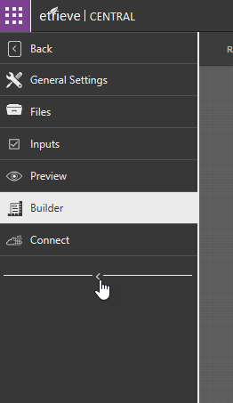
Form Builder
Clicking the arrow below the tabs on the left of the window will collapse the menu for more working space n screen.

Slide 13
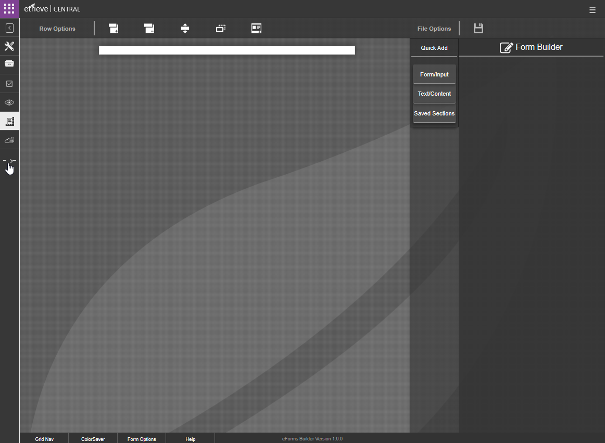
Form Builder
When collapsed, clicking the arrow will reopen the full-size tabs.

Slide 14
Form Builder Top Menu
Clicking the Add Row button will add a new Row to the Form.
Clicking the Move Row button will prompt the user to select a row to move to a new row position.
Clicking the Save button will save all current work in the Form.
Work in Form Builder does not save automatically.
Recommended you save every time you’re done with the current row you’re designing.
The Quick Add button will allow the user to select from preconfigured rows.
Clicking the Duplicate Row button will duplicate the selected Row.
Clicking the Delete Row Button will prompt the user to select a Row to delete.

Slide 15
Form Builder Bottom Menu
Clicking the Grid Nav button will open the Grid Navgation Panel. This allows a user to easily select rows, columns, elements, and access items hidden by data-binds.
Clicking the Form Options button will open the Form Options panel. This provides access to add code to the Body and Header tags of the Form.
The Form Builder version is shown in this panel.
Clicking the ColorSaver button will open the ColorSaver Panel. This gives the user access to frequently used colors.
Clicking the Help button will open the Help tool which provides tutorial information for Form Builder.

Slide 16
Form Builder Overview
Forms are comprised of 3 nested components:
Rows
Columns
Elements
Rows and Columns define positioning on Forms
Elements contain data used or displayed on Forms
Row
Column
Element

Slide 17
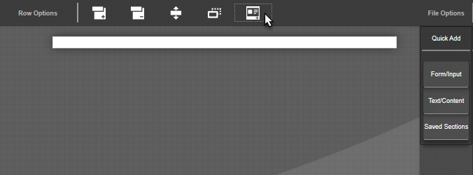
Quick Rows
Pre-formatted and reusable rows
Form/Input
Accept data from users
Text/Content
Static text and images
Saved Sections
User created rows

Slide 18
Understanding Rows, Columns, & Elements

Slide 19
Rows
Rows define vertical position on a Form
Rows can contain up to 12 Columns
Rows can be moved up or down on a Form
Rows can be set to be dynamic
Allows user to add or subtract duplicate Columns in a single Row
HTML properties, CSS styles, and JS classes can be added to Rows

Slide 20
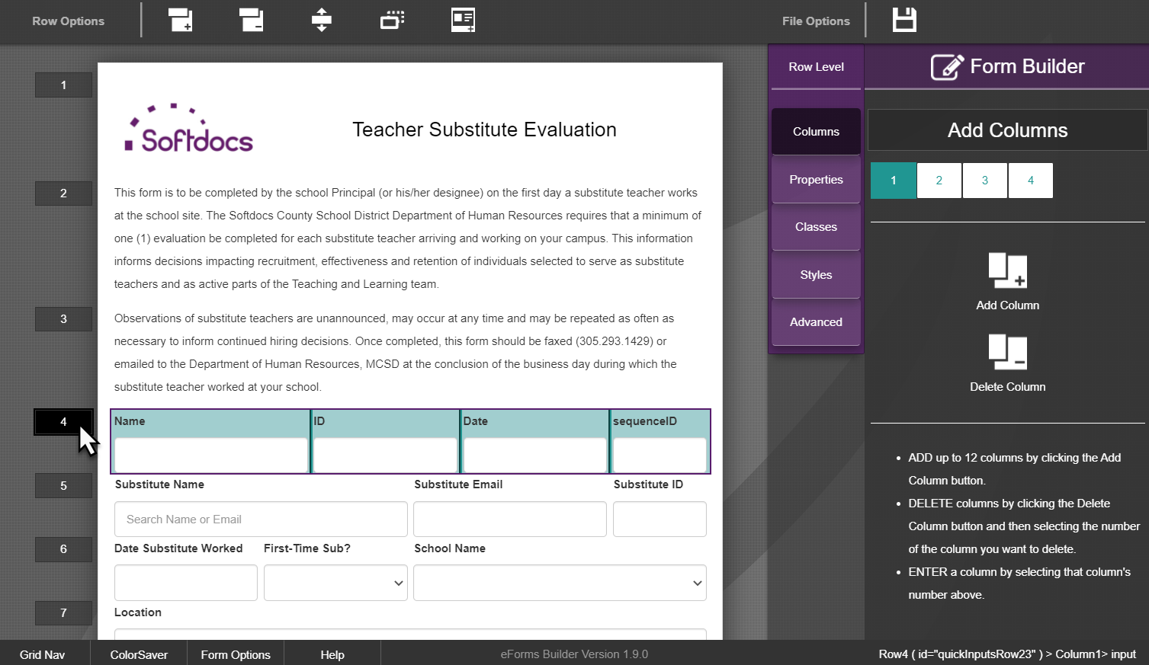
Rows
Rows are accessed by clicking on the row number

Slide 21
Columns
Columns define the vertical and horizontal position of Elements in a Row
Columns can contain up to 12 Elements
Columns can be moved within a Row
Columns cannot be moved from one Row to another
HTML properties, CSS styles, and classes can be added to Columns
Adjust Column widths, not Element widths

Slide 22
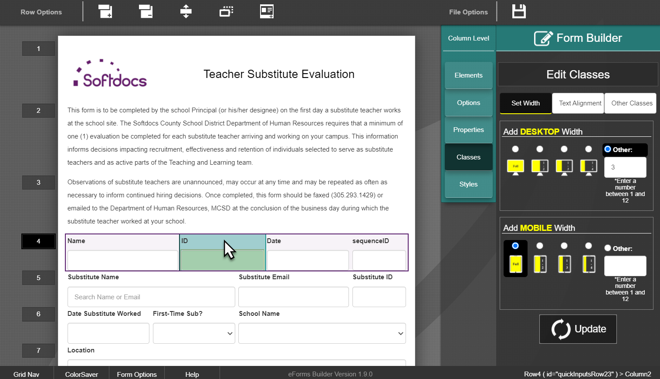
Columns
Columns are accessed by clicking on the column in the row

Slide 23
Columns
Adjust widths from the column level

Slide 24
Elements
Display or accept information on a Form
Elements can be moved within a Column
Elements cannot be moved from one Column to another
HTML properties, CSS styles, and classes can be added to Elements

Slide 25
Elements
Can display static information
Images
Text
Headings
Paragraphs
Lists
Separating Lines
Can display dynamic information
User Information
JavaScript function results
Date ranges using the current date
Numeric Calculations
Values based on other inputs
Information from integrated databases

Slide 26
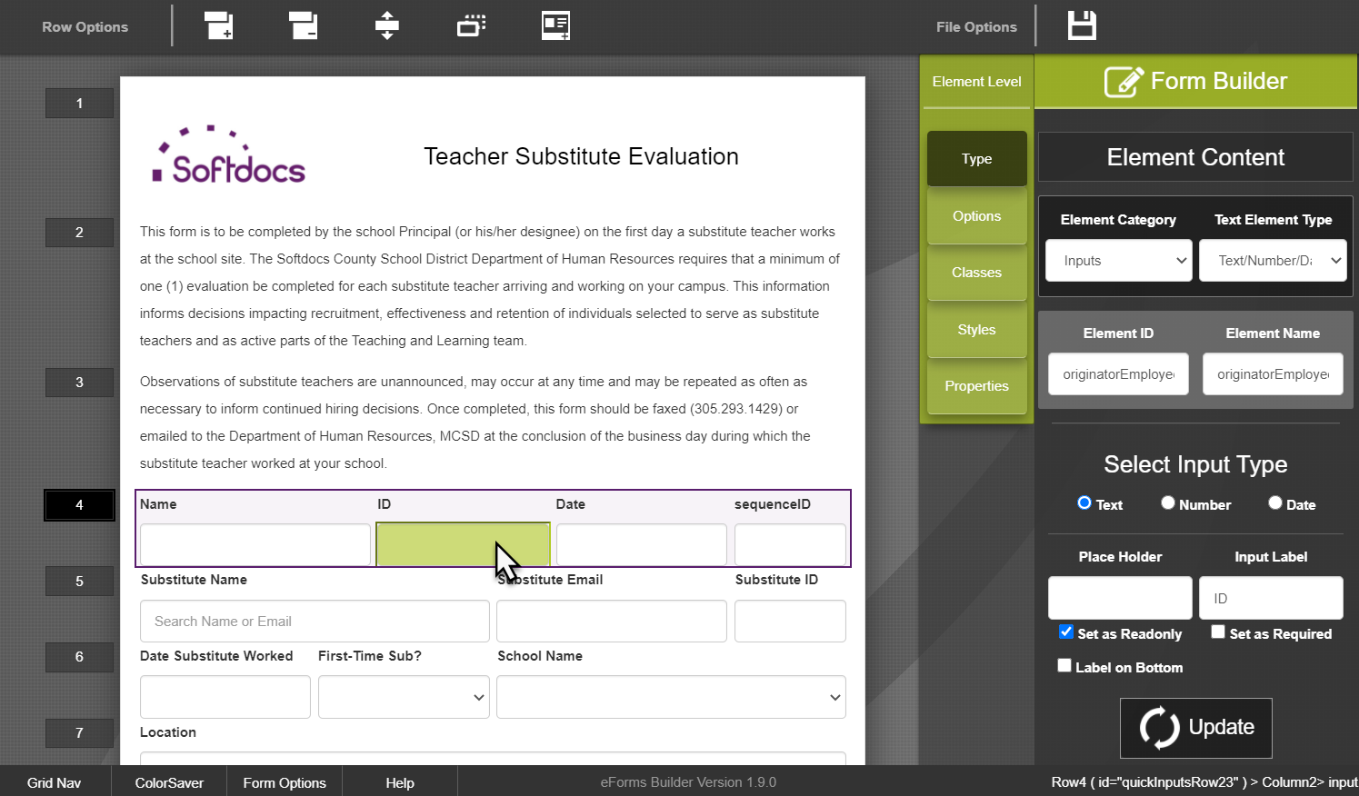
Elements
Elements are accessed by clicking on the field or text in the column

Slide 27
Form Builder Navigation

Slide 28
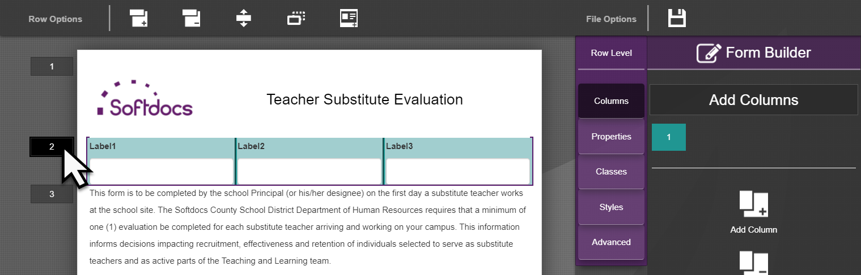
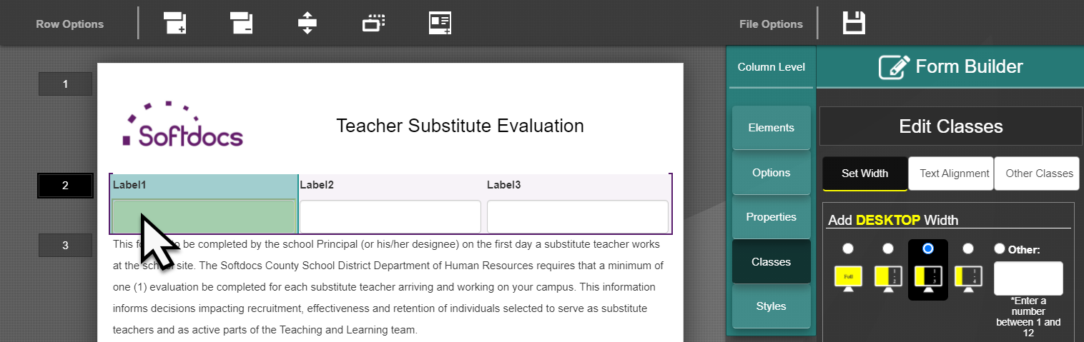
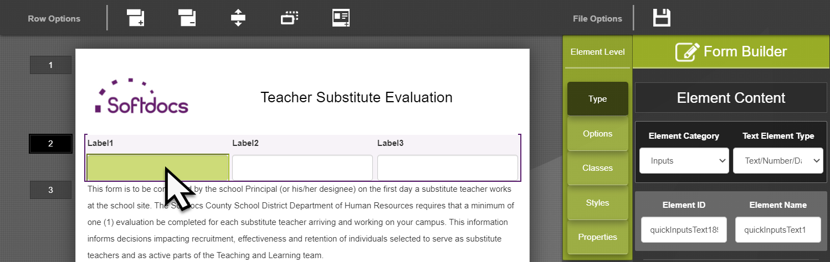
Navigating the Form Builder
1 Click to edit Row
2 Clicks to edit Column Width
3 Clicks to edit Column Element
1
2
3

Slide 29
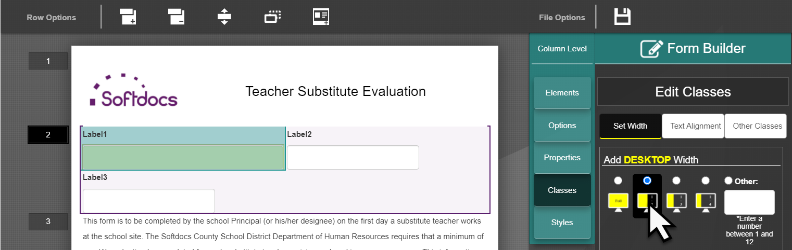
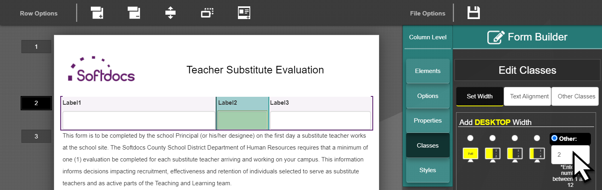
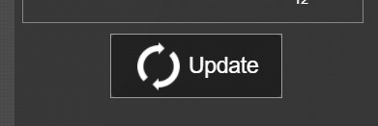
Editing Column Widths
Columns will “wrap” down if there is not enough space
Adjust column widths before editing column elements
Click Update to apply changes!!

Slide 30
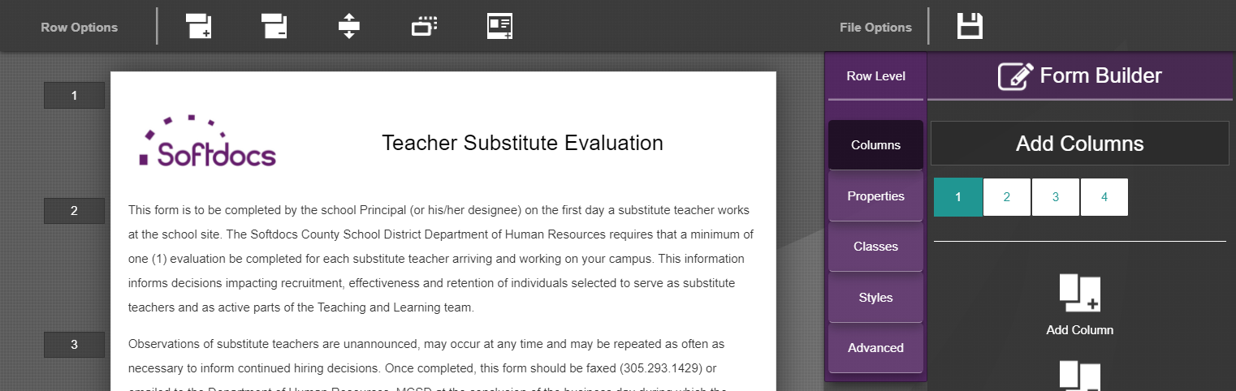
Saving Your Form
Save your progress once you’re done editing the row you’re on.
Save will replace all form files except for viewmodel.js

Slide 31
Editing Elements

Slide 32
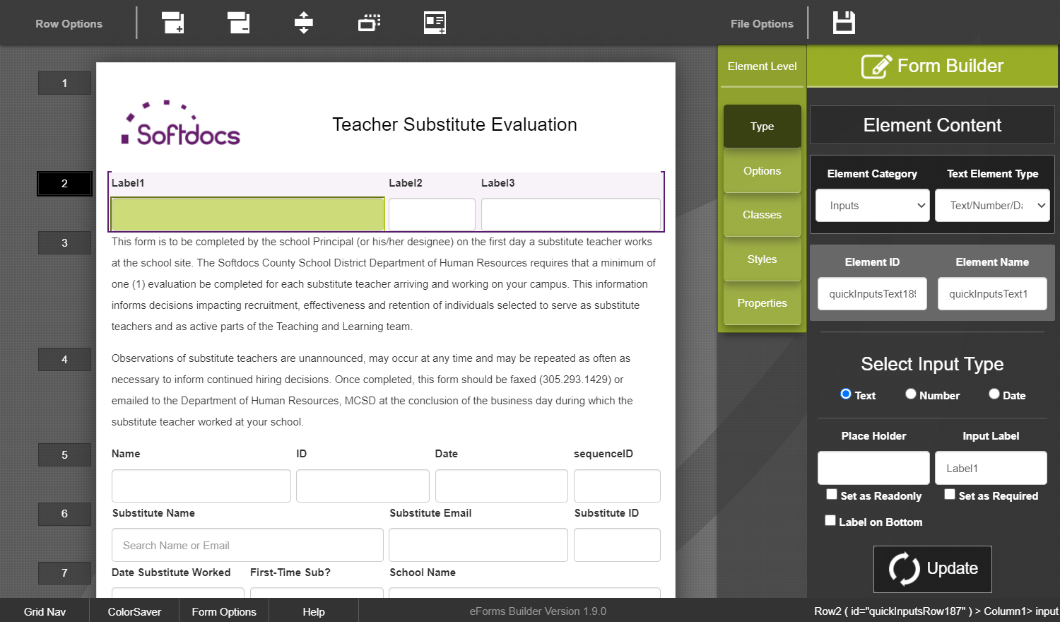
Editing Text Elements
Always update Element ID
Unique + no special characters
Element Name same as Element ID
Update Input Label
Visible on the form
Required?
On Origination or when visible
UPDATE!!

Slide 33
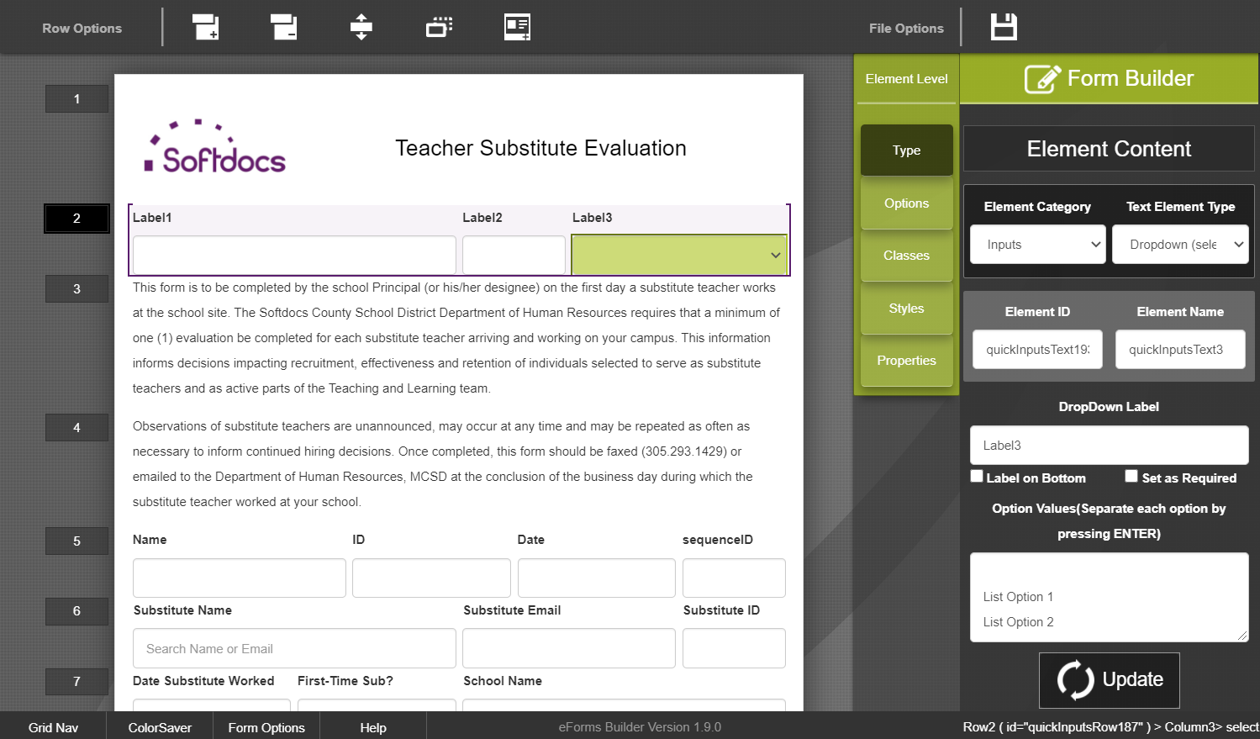
Editing Drop-Down Elements
Update Element ID + Element Name
Update DropDown Label
Required?
Option Values
First option blank
List options in alpha order
Place “Other” at bottom
UPDATE!!

Slide 34
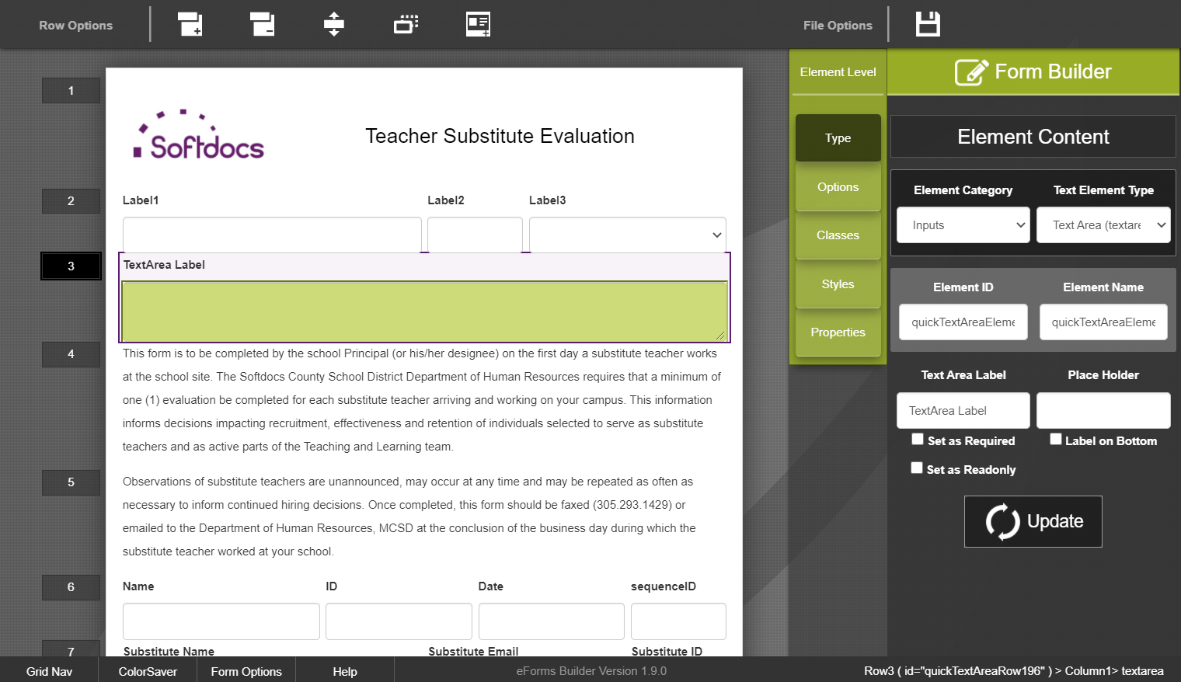
Editing Textarea Elements
Update Element ID + Element Name
Update Text Area Label
Required?
Place Holder (if applicable)
Provides additional instructions to user
UPDATE!!

Slide 35
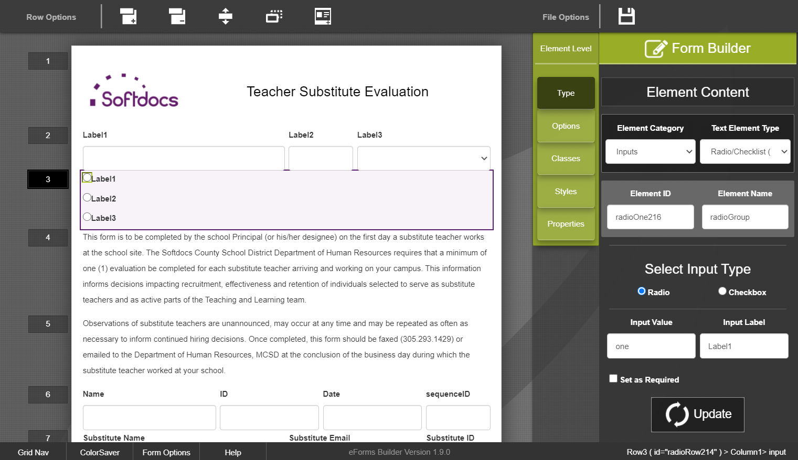
Editing Radio Button Elements
Element Name = Group Name
All radio buttons will have the same name
Input Label
What users see
Input Value
What data is stored
Element ID
Combination of Name + Value
Required?
Set all radio buttons to required
UPDATE!!

Slide 36
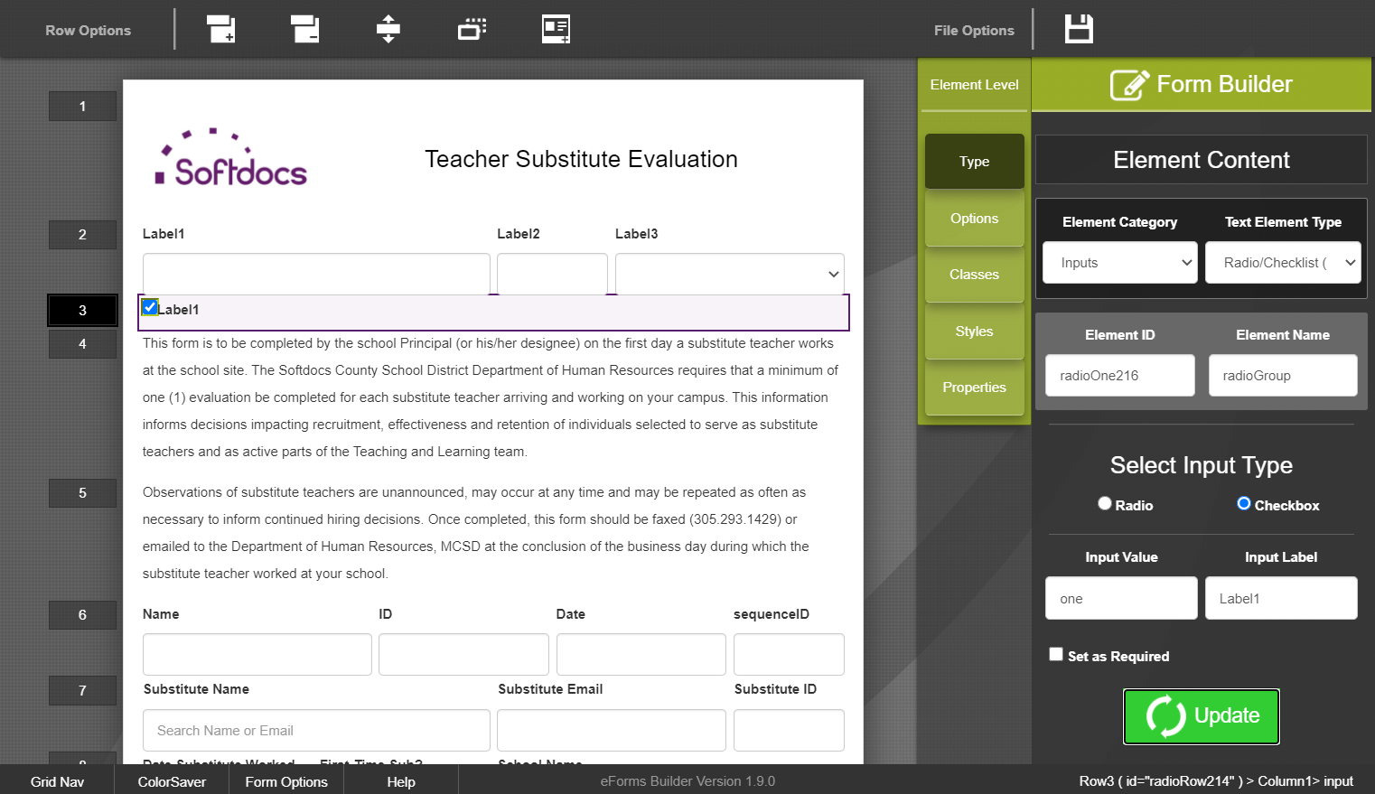
Editing Checkbox Elements
Update Element ID & Name
Select Input Type Checkbox
Input Label
What users see
Input Value not used
Required?
UPDATE!!

Slide 37
Customized Rows

Slide 38
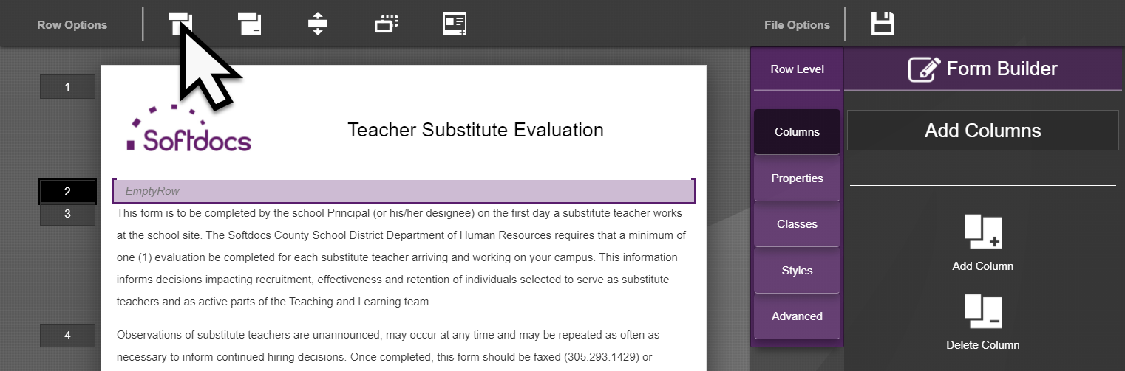
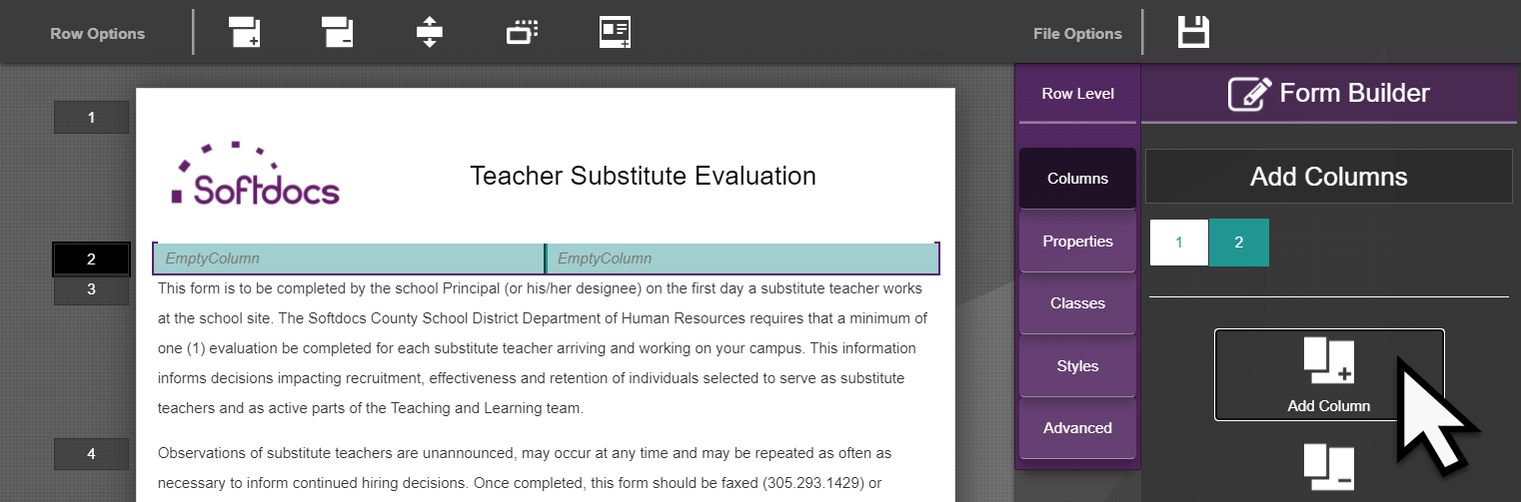
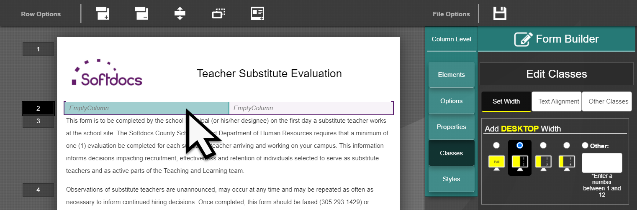
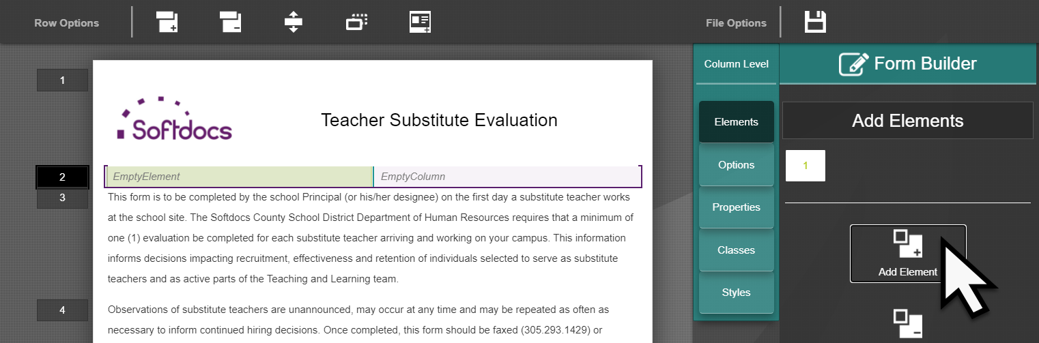
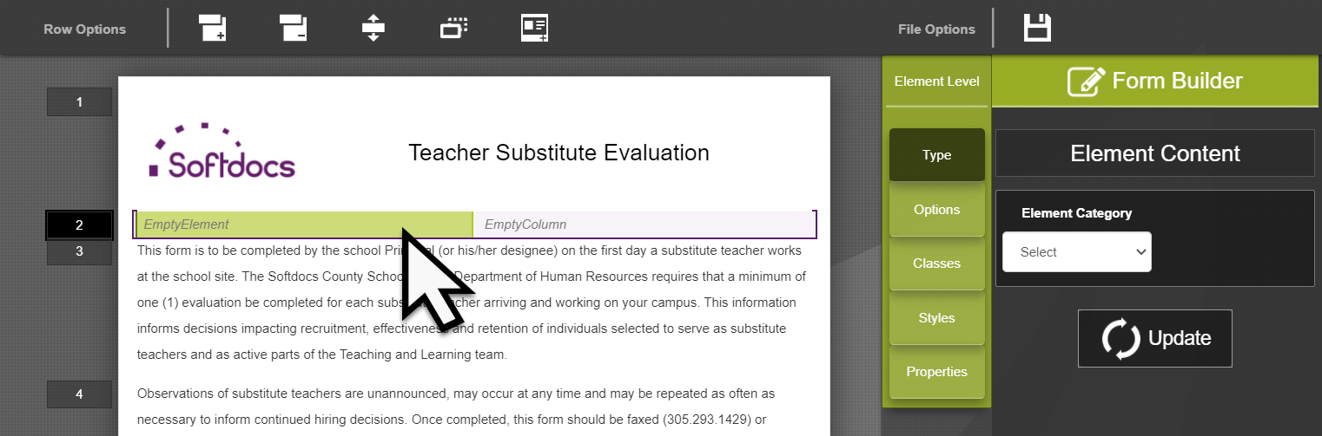
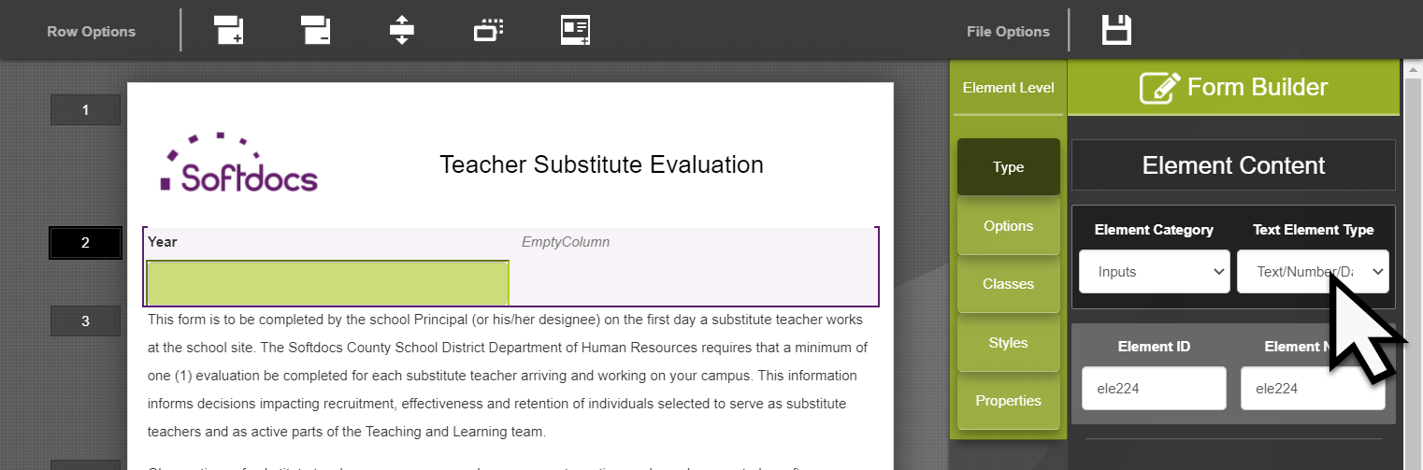
Building Rows Without Quick Rows
Click Add Row (1)
Add the Columns (2)
Adjust Column Widths (3)
Click Update
Add an Element (4)
Edit the Element (5-6)
Click Update
1
2
3
4
5
6

Slide 39
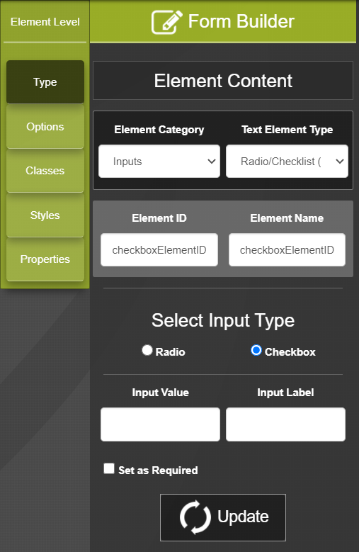
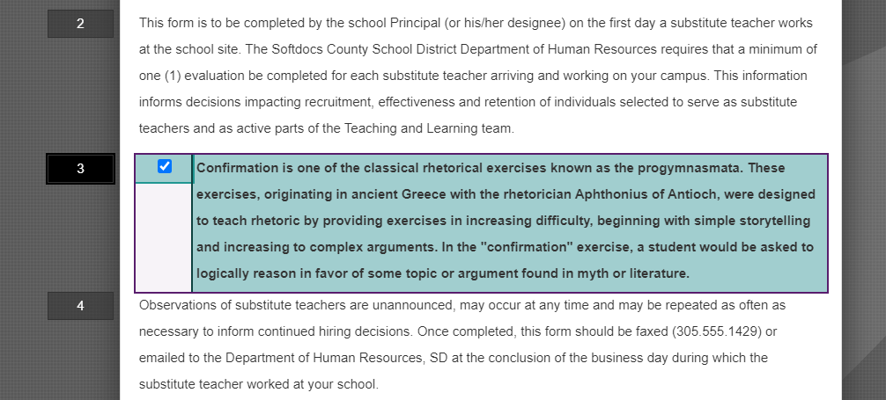
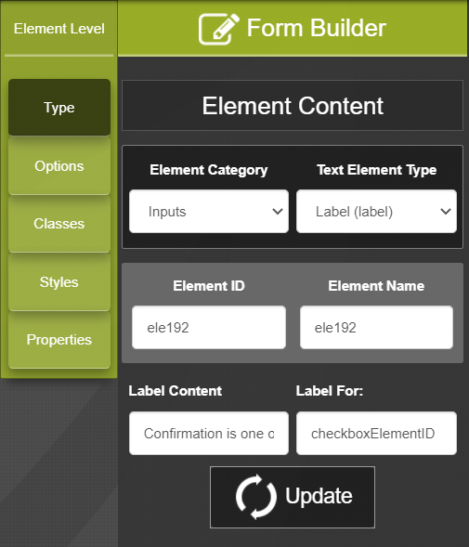
Checkboxes in Separate Column as Label
In some cases, checkboxes may need to be designed where the checkbox is in a different column as the label.
Setup the checkbox:
Centered within column
No label data
Unique Element ID
Setup the label:
Label Content
For the checkbox’s Element ID

Slide 40
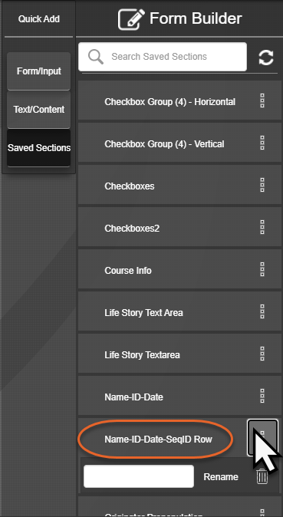
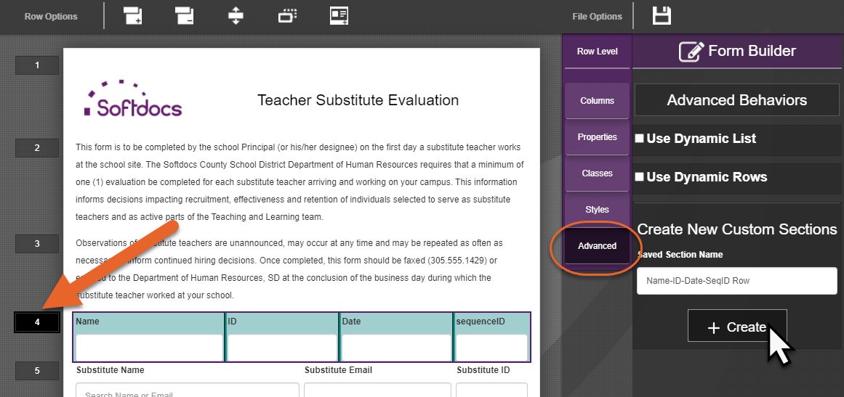
Saving Customized Rows
Click the Row you want to save
Click Advanced
Enter the saved row name & click Create
You can only rename or delete Saved Sections

Slide 41
Additional Functions

Slide 42
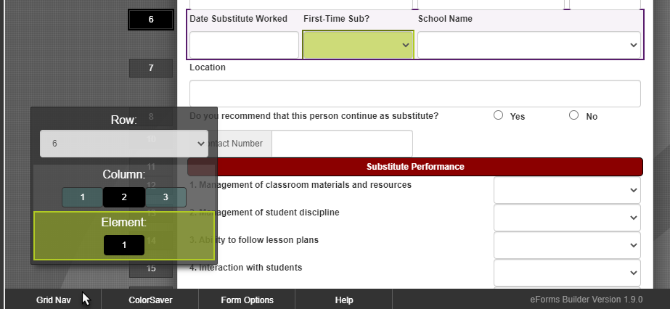
Additional Functions: Grid Nav
Clicking on “Grid Nav” will open the Grid Nav dialog box.
The box can be moved around on the screen to avoid working areas.
Click “Grid Nav” to close the dialog box.

Slide 43
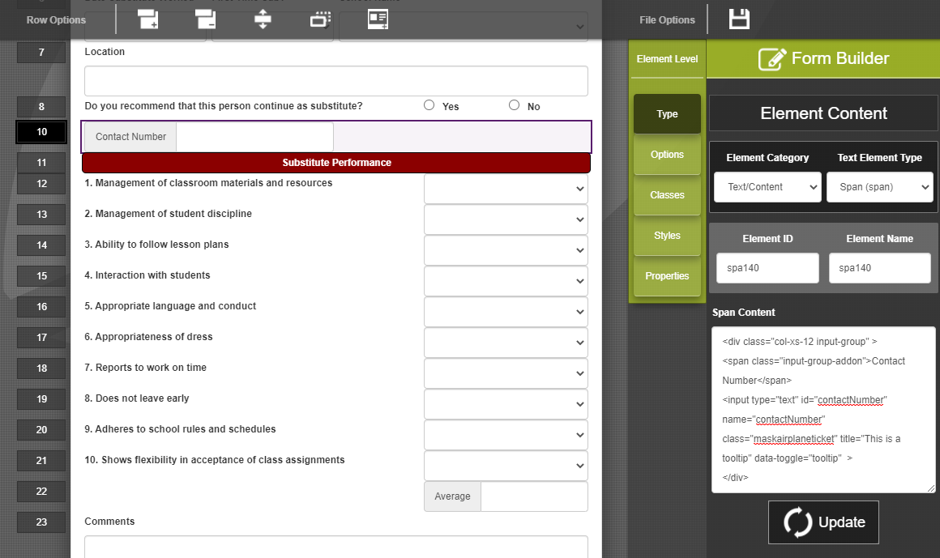
Additional Functions: HTML in SPAN
If the Form Builder functions cannot handle what you’re trying to design, place HTML directly into a SPAN tag.

Slide 44
Do’s and Don’ts

Slide 45
Do’s and Don’ts
Do: Use the column to adjust width Don’t: Use the element to adjust width
Form Builder works best if column widths are adjusted and all contents within the column adhere to the column width.
Do: Use the Duplicate Row function Don’t: Use it without saving and refreshing your browser first
The form builder may experience issues when duplicating a row. Saving & refreshing will guarantee the duplication works.

Slide 46
Best Practices

Slide 47
Best Practices
Do not copy the paper form line by line
Use the Form Builder’s style to put new life into the form
Take this opportunity to look for process improvements
Look for points of integration and workflow
Don’t build anything that was there because of paper
Start asking “why is this field here?”

Slide 48
Best Practices
Break a paper form down in Rows
Form width is limited, but not Form height
No need for typed signatures
Digital signatures are handled within Etrieve’s Workflow
Use the Quick Add Rows!
It’s easier to edit a row than it is to start from nothing.

